Slide 1
MMS Athletics Parent Meeting
Athletic Director: Brian Yoshikawa
Yoshikawa_brian@cusdk8.org
*This PowerPoint will be available online at https://sites.google.com/cusdk8.org/mryosh/after-school-sports?authuser=0

Slide 2
Purpose of Today’s Meeting
Discuss the structure of our league (VAL)
Introduce the coaches
Tryout Sports vs. Non-tryout Sports
Review game and practice schedules
Discuss the registration process
Discuss transportation
Answer any questions

Slide 3
League-VAL
11 teams including Miller Middle School
Teams from Cupertino, Sunnyvale, Los Altos, & Mountain View School Districts
League Website: http://www.valleyal.org
Season Schedules
League Standings

Slide 4
League Website Example

Slide 5
More League Website Examples

Slide 6
Coaches
Please contact the coaches with specific questions about your grade level team (tryouts, practices, games/meets):
Cross Country
Ms. Emerson (Head Coach) – emerson_kari@cusdk8.org
Mr. Kato (Assistant Coach) – gkato1973@hotmail.com
Mrs. April Goodman-Orcutt (Assistant Coach) - goodman-orcutt_april@cusdk8.org
Boys Basketball
Coach Pratinav Sharma (6th Grade) – pratinav.e.sharma@gmail.com
Coach Alan Fong (7th Grade) – alanhoafong@gmail.com
Coach Doug Fong (8th Grade) – dougfong@me.com
Girls Softball
Coach Lucy Howng (6/7/8) - lucysyh@gmail.com

Slide 7
Tryout Sports vs. Non-Tryout Sports
Tryout Sports include: Softball, Basketball, Volleyball, and Soccer
All tryout sports must have the following before trying out:
A completed tryout waiver completed and submitted online (example on next slide)
You can find the tryout waiver at www.valleyal.org
The link will be on the left hand side and labeled “CUSD Tryout Waiver”
Make sure you choose the correct sport and school
You should receive a confirmation email once it’s submitted
Non-tryout Sports include: Cross Country, Wrestling, and Track
All non-tryout sports must have the following before competing:
Enrollment on the team (Can be done on the league website once the enrollment button becomes active)

Slide 8
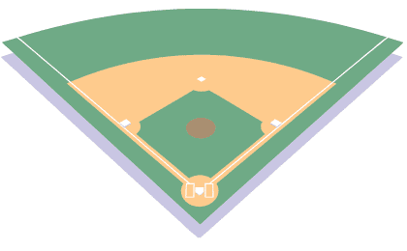
Why join the Miller Girls Softball Team?
2nd Base: Combines athleticism and strategy… it’s like a physical chessboard with a lot of rules
3rd Base:Involves math and statistics, think Moneyball
1st Base: Engage in outdoor physical activity within an encouraging, fun TEAM environment
Homerun: Get a head start as almost all high schools need players and colleges offer scholarships

Slide 9
Dates: Tryout August 21 & 22 from 3:15-4:15pm
Equipment: Glove/bat/helmet (if you have any), athletic wear or PE clothes
Experience: None, just willingness to learn and play; hand-eye coordination from other sports such as tennis, golf, cricket helps a lot

Slide 10
Example of the Tryout Waiver Form

Slide 11
Tryout Schedule
Tryouts can begin on day 1 of the season (Monday, August, 21st)
Tryout waivers should be completed the Sunday before tryouts begin
A tryout waiver must be completed before your child can tryout. NO EXCEPTIONS.
Tryouts begin after school and run till about 5
You can contact coaches with specific questions about practices/games
Usually, tryouts are at least a 2-3 day process (again, contact a specific coach if you have any questions)

Slide 12
Practice/Game Schedule
The team schedule can be found at www.valleyal.org
Cross Country
M, T, F practice when meets start
W are meet days starting 9/6
Practices are usually 3:15-4:15; meets start at 4:00
Basketball
Only go 4 days a week (with the exception of tryout week) Aug. 21-25
Usually 2 games per week (Sometime 3 games in a week and 1 practice)
Softball
Only go 4 days a week (with the exception of tryout week) Aug. 21-25

Slide 13
Registration
2 steps to register:
Complete the Tryout Waiver found on www.valleyal.org
Then, AFTER your child has made the team…
2) Click the “Enroll” button for the sport your child wants to play, create a TeamSideline account, and PLEASE make a donation when you add your child to the team.
***DO NOT enroll/make a donation for your child on a tryout sport until you know they have made the team. All donations made will not be refunded by the District***

Slide 14
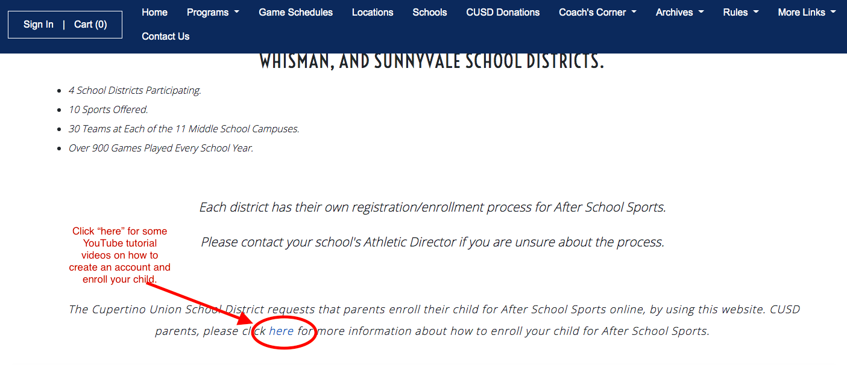
Registration Tutorial
If you need help with registration, adding your child to a team, making a donation, etc… there is a link that will take you to YouTube videos to help you. Below is a screenshot of where to look on the league homepage.

Slide 15
Donations
After School Sports is primarily funded by parent donations, so we ask each family to donate $125 each season their child participates in an After School Sport
Your donation covers the following:
Coaches, referees, uniforms, & equipment

Slide 16
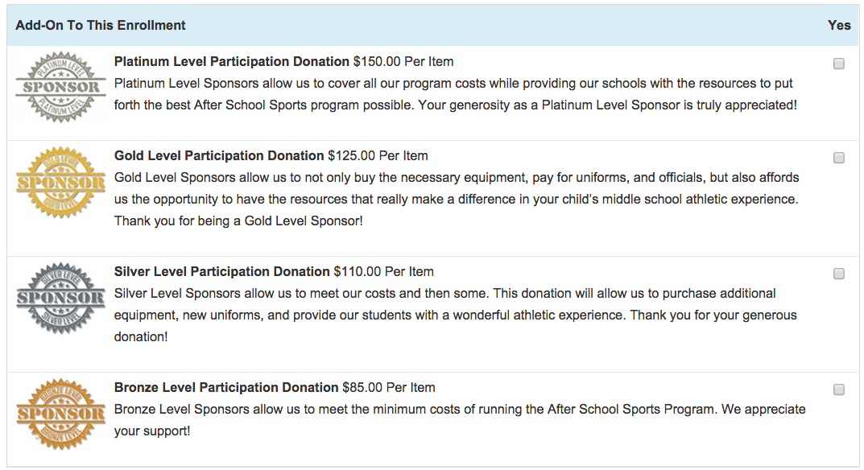
How Do I Donate?
There are two ways to donate
Preferred method: Donate online through PayPal when you register your child (PayPal account is NOT required to donate)
2) You can also attach a check to your Athletic
Participation Packet and give it to the AD

Slide 17
Eligibility
Must maintain a 2.0 GPA and have no more than 1 ‘U’ in citizenship
Students who fail to maintain this will be placed on probation, which means…
Can participate in practice, but not games
If problems continue, then removal from team may be necessary
Coaches may also place athletes on probation for discipline issues

Slide 18
Competitions
Teams goal is to win each contest while developing skills and having fun
Coaches will try and give all participants playing time – will not be equal
Playing time is at discretion of each coach – please respect that

Slide 19
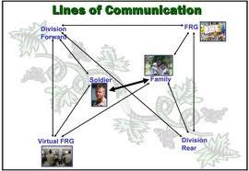
Lines of Communication
If an athlete has an issue he/she should…
Step 1: Athlete talks to coach
Step 2: Parent talks to coach
Step 3: Parent and/or coach talk to AD- Brian Yoshikawa
Step 4: AD talks to assistant principal – Debbie Lopez
Step 5: AD talks to principal- Anu Iyer

Slide 20
Transportation
Due to the excessive cost of busing, no buses will be provided
Parents/athletes are responsible for obtaining their own transportation to and from games
Parents may organize carpools if they so choose

Slide 21
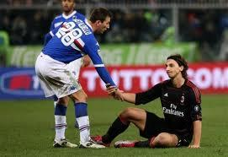
Sportsmanship
Keep cheering positive and respectful
Unaccepted behaviors that will result in ejection:
Verbal abuse to coaches, refs, players, spectators
Obscene language
Physical violence or threats

Slide 22
Prior To Playing
The following steps need to be completed prior to playing in a game:
1) Fill out the CUSD Tryout Waiver and Form at www.valleyal.org
2) Create a TeamSideline account at www.valleyal.org
3) Click the “Enroll” button for the sport your child wants to play and follow the prompts
4) PLEASE make a donation when you add your child to the team
5) Complete your donation via PayPal (PayPal account NOT required to donate)

Slide 23
Questions
If you have any questions, please EMAIL: yoshikawa_brian@cusdk8.org
I will do my best to get answers to you in a timely manner
Principal:
Anu Iyer iyer_anu@cusdk8.org

Slide 24
Practice/Game Schedule
The team schedule can be found at www.valleyal.org
Cross Country
M, T, F practice when meets start
W are meet days starting 9/6
Practices are usually 3:15-4:15; meets start at 4:00
Basketball
Only go 4 days a week (with the exception of tryout week) Aug. 21-25
Usually 2 games per week (Sometime 3 games in a week and 1 practice)
Softball
Only go 4 days a week (with the exception of tryout week) Aug. 21-25
In order to tryout for Basketball tryout waivers must be completed by Sunday 8/20
In order to participate in Softball, enrollment must be completed by Sunday 8/20

